Slide 1
Course Project Maven supplies raw
File created on: 2/19/2021 12:34:59 PM

Slide 2
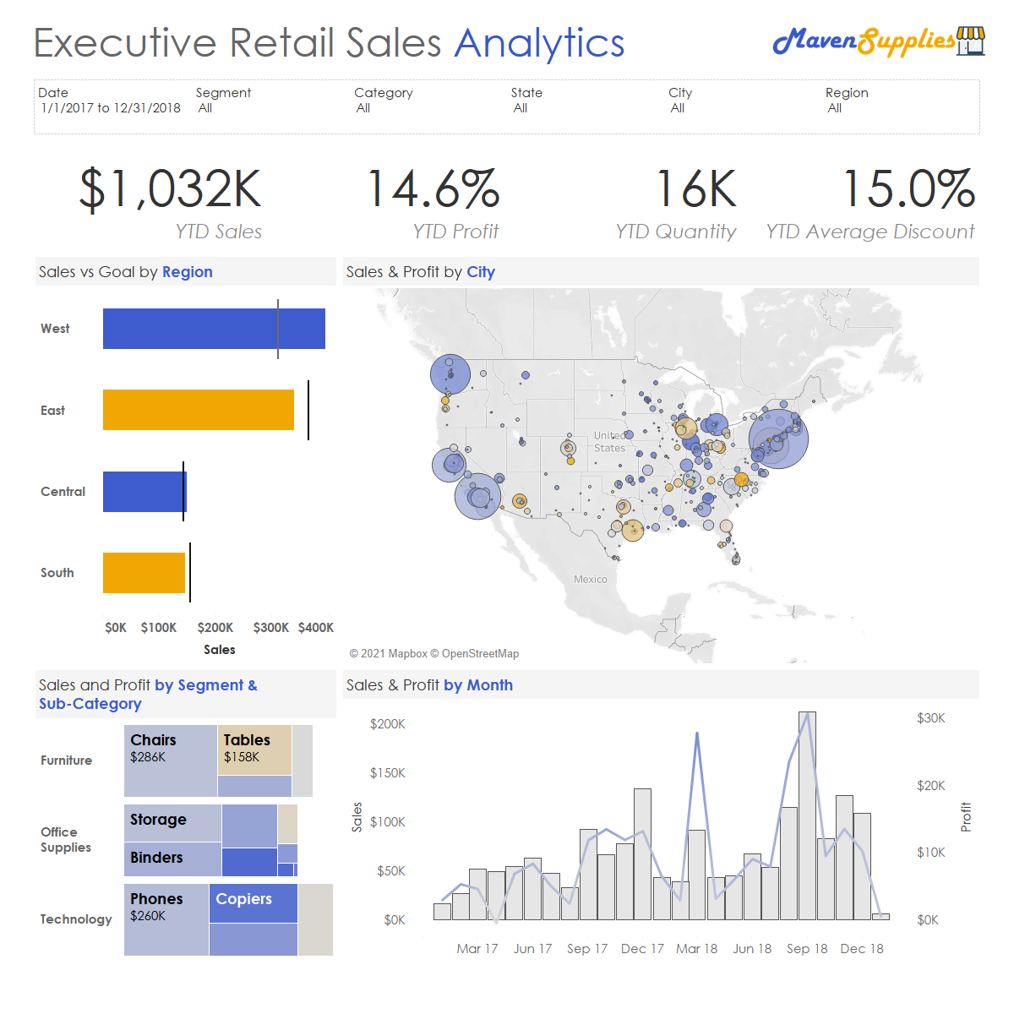

Slide 3
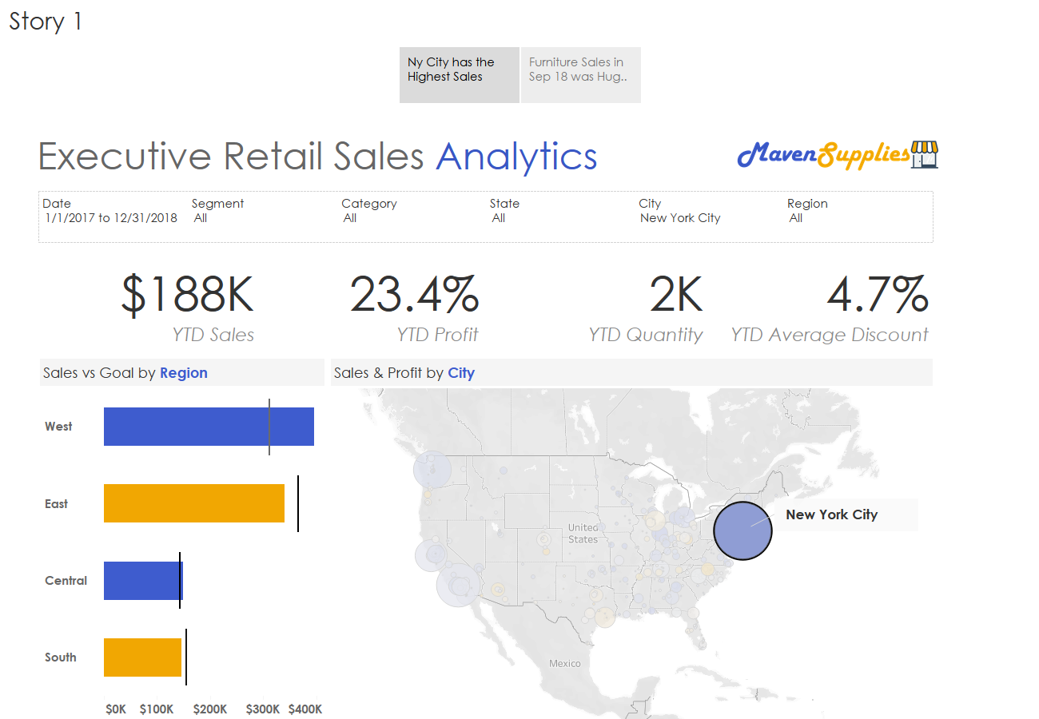

Slide 4
